Slide 1
AZURE HACKATHON
Team Members
Pallavi Suma
Mahalaxmi
Karthika
Rachel

Slide 2
Spam Message Detection In Messenger
-Using Machine Learning

Slide 3
ABSTRACT OF THE PROJECT
The main objective of this spam message detection in messenger applications is to eliminate pressure on unwanted messages. Today many girls are going through cyber bullying, to overcome this problem this is a contribution of making the messenger free from those messages
which are harmful and useless not only to women but to everyone who is into social media.
THE

Slide 4
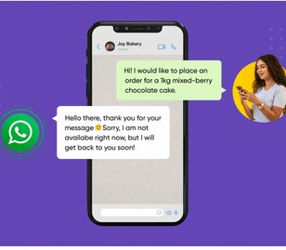
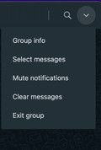

Project Functionality
SPAM-20

Slide 5
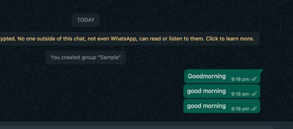


Classification Of Spam Messages
Repeated Texts
Displaying the repeated texts only once and marking the other repeated messages as spam
Categorize the other 2 messages as spam

Slide 6
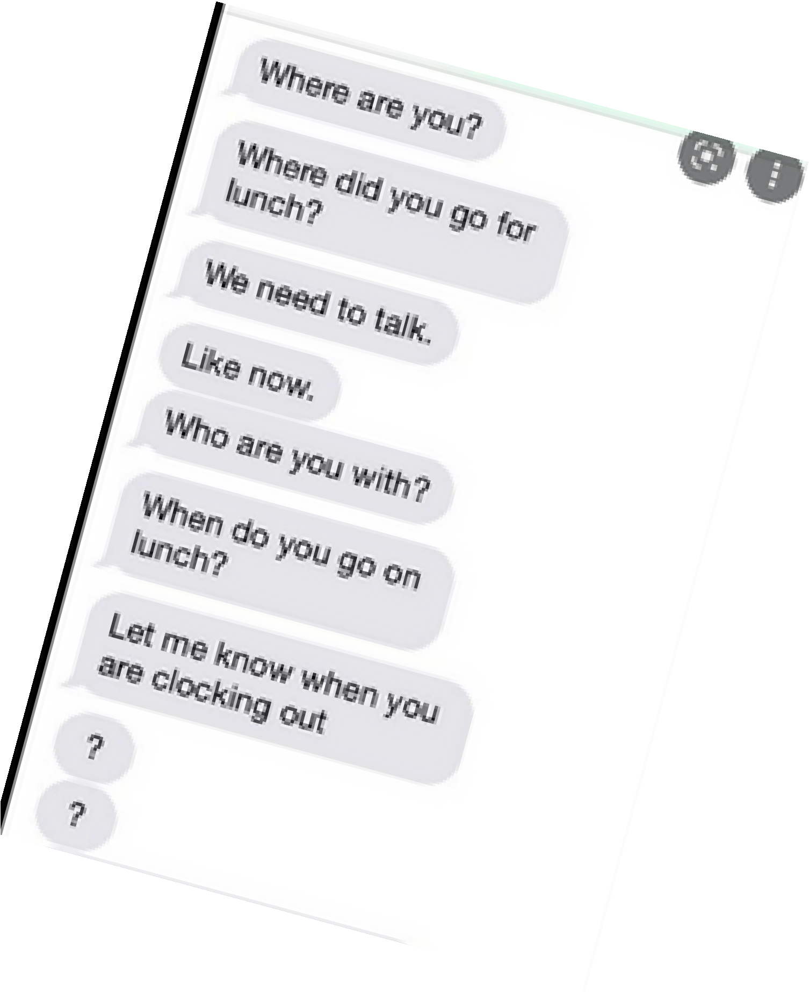


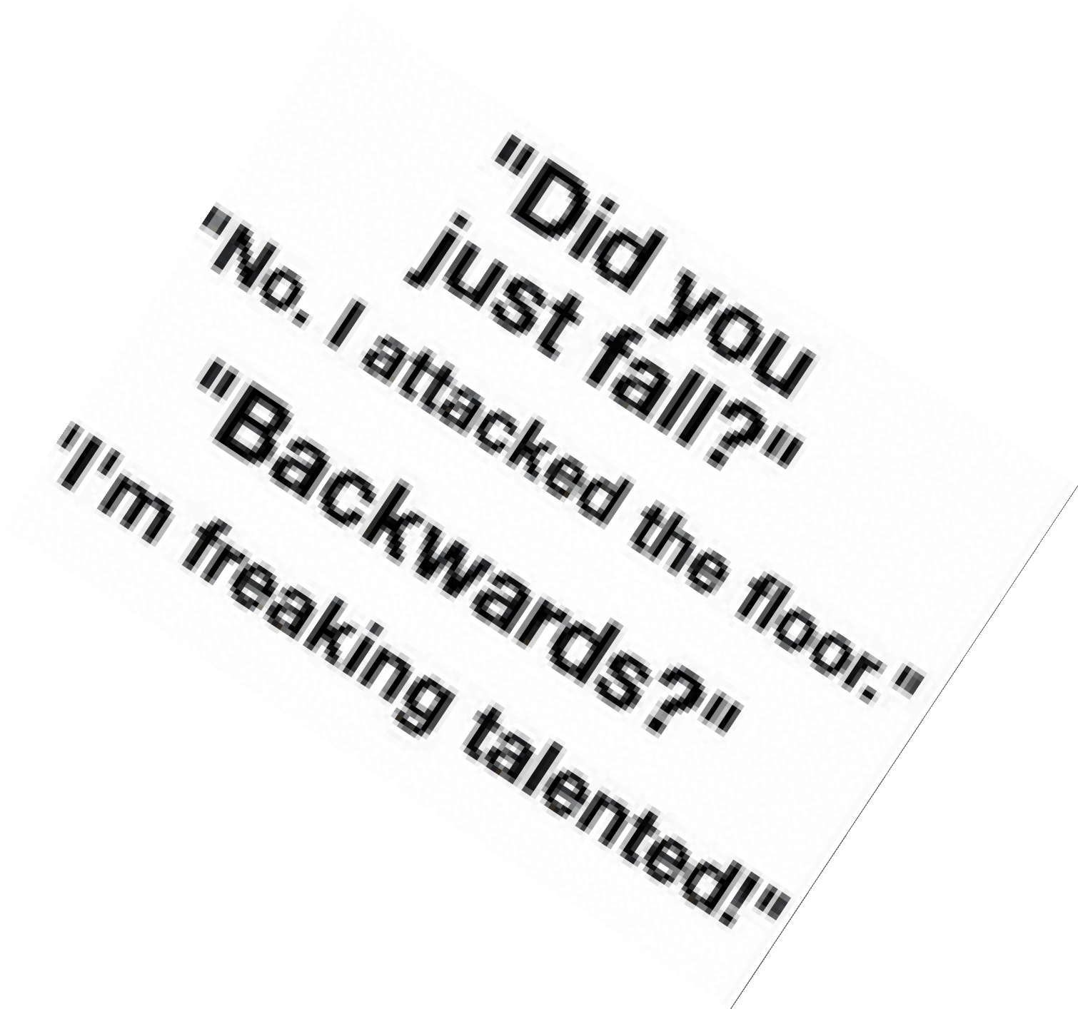

Abusive Messages And Sarcastic Messages
All the messsages that are abusive and sarcastic coming from the unkown contacts should be marked as spam . Even messages that are abusive and they are in the contact list are should also be marked as spam

Slide 7
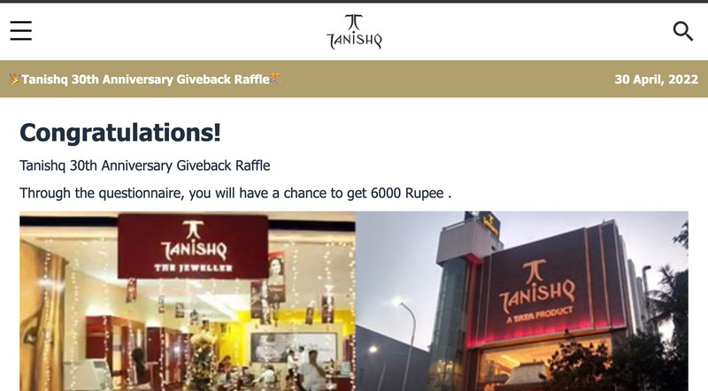
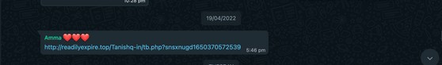

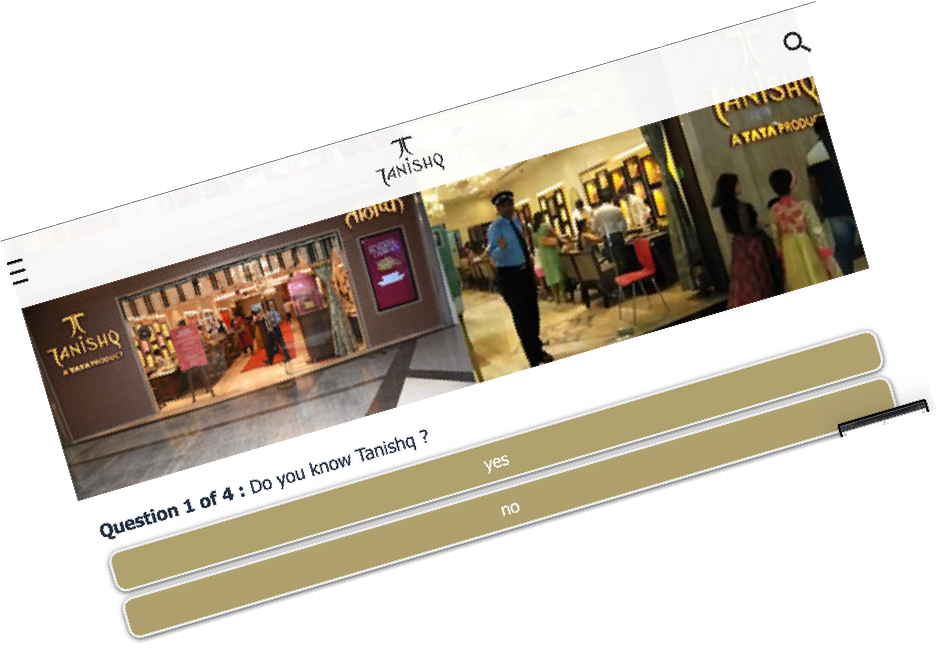
Fake link Messages

Slide 8
SOFTWARE REQUIREMENTS
Python3-Libraries
Sktlearn
Streamlit
Nltk
Pandas
Azure Virtual Machine

Slide 9
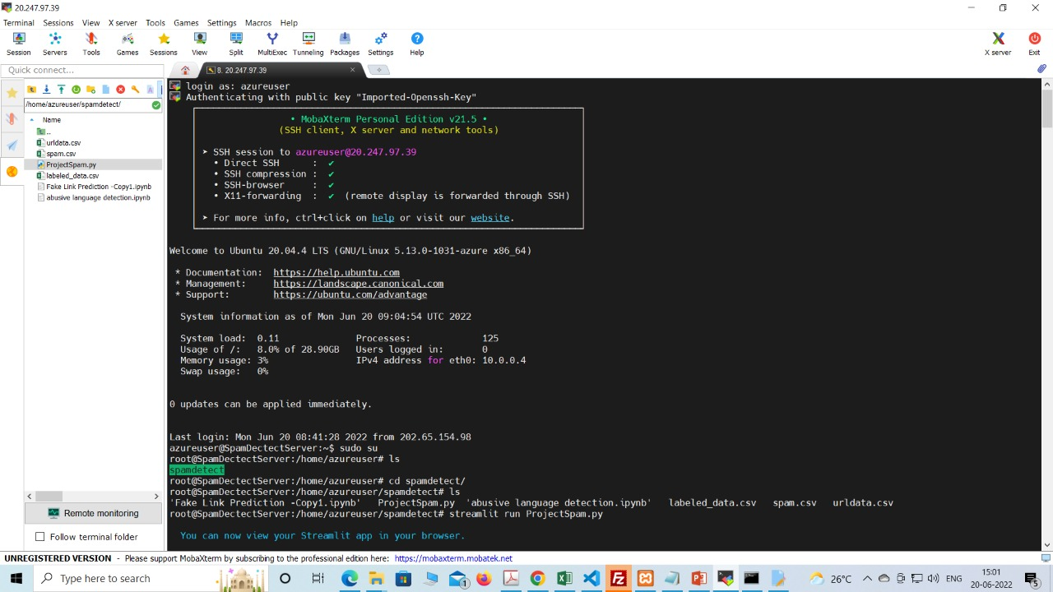
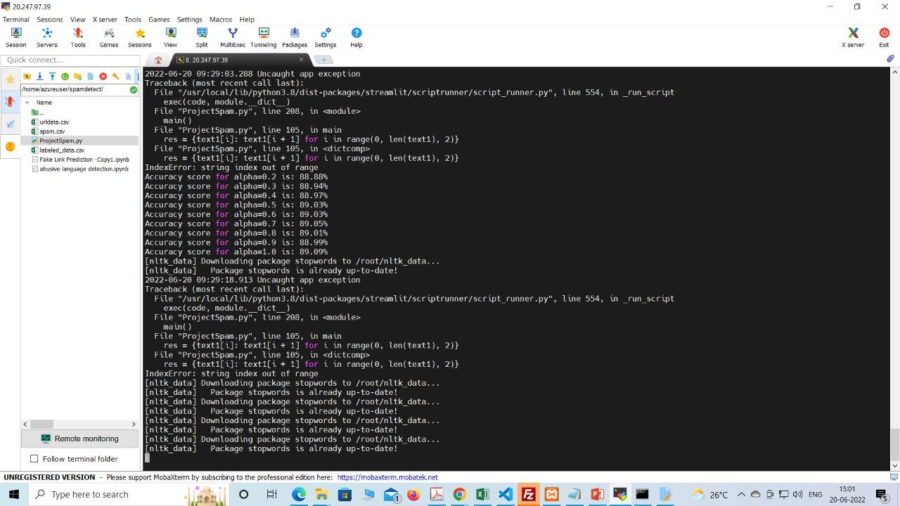
Azure services

Slide 10
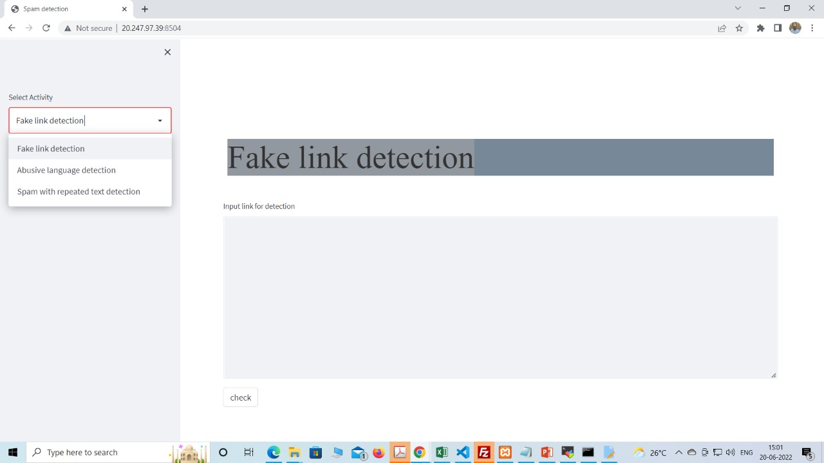
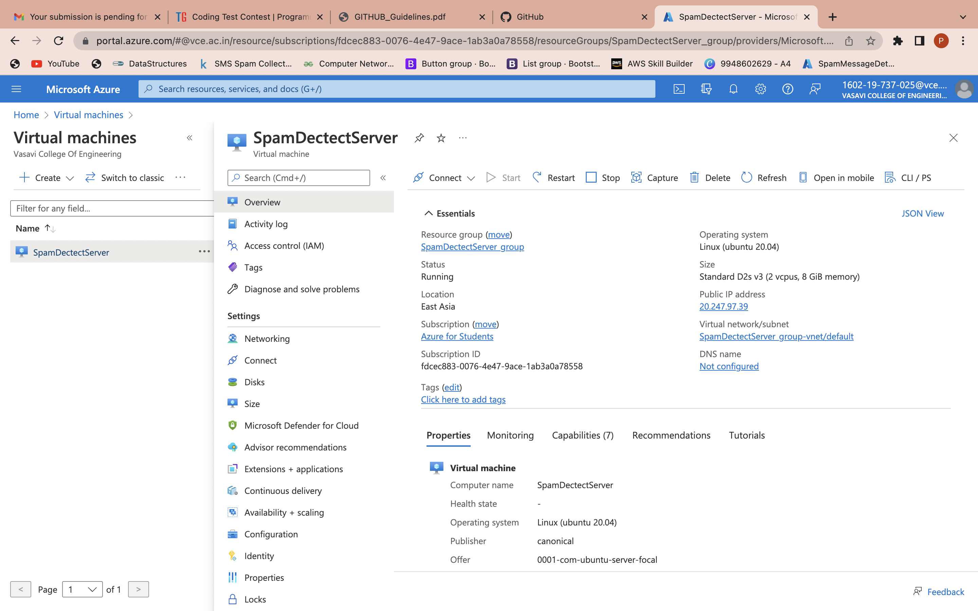
Running on Virtual Machine

Slide 11
FUTURE SCOPE
Linking this model to existing messenger which
are trending helps in detection our project's
final scope and messenger can be Facebook, What’sApp, etc.

Slide 12
Thank you

